Slide 1
Law of reflection on a curved mirror Lab1

Slide 2
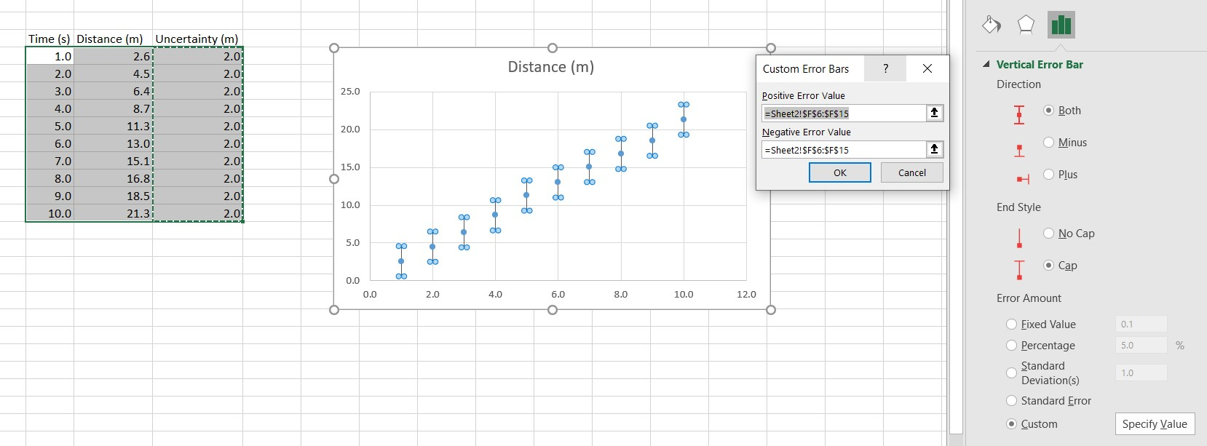
Prelab 1

Slide 3
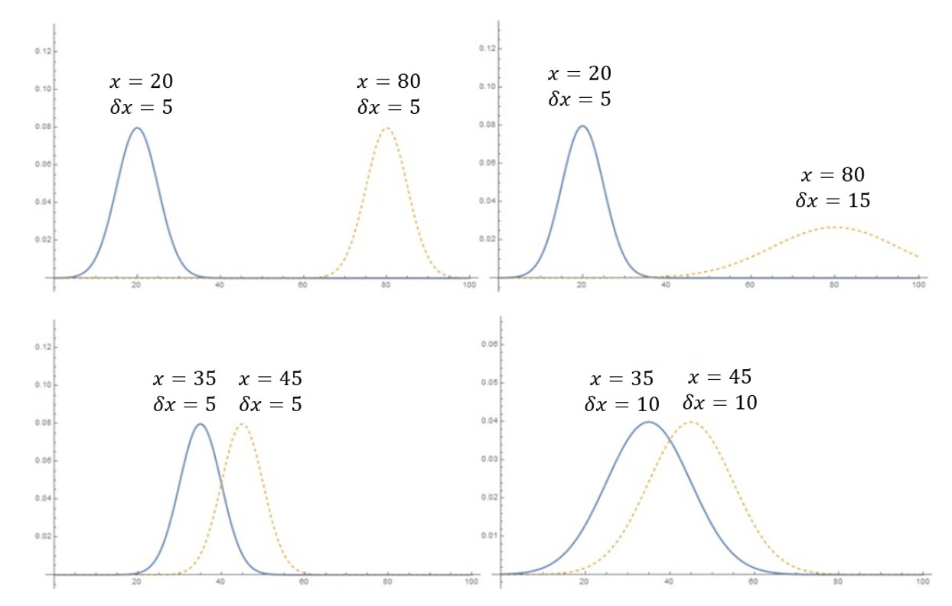
Prelab 1 Invention Activity: Think, pair, share

Slide 4
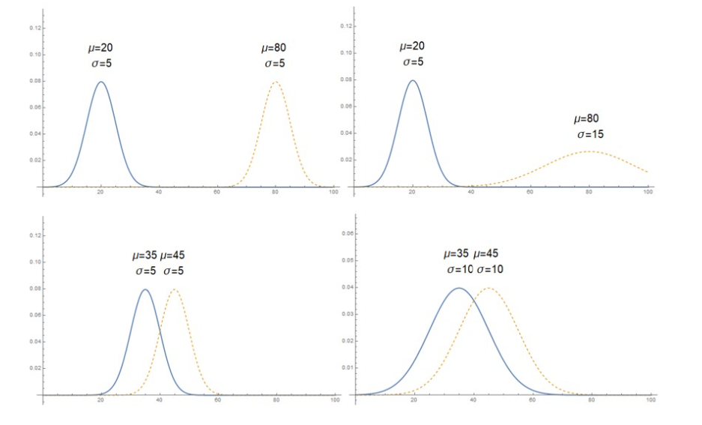
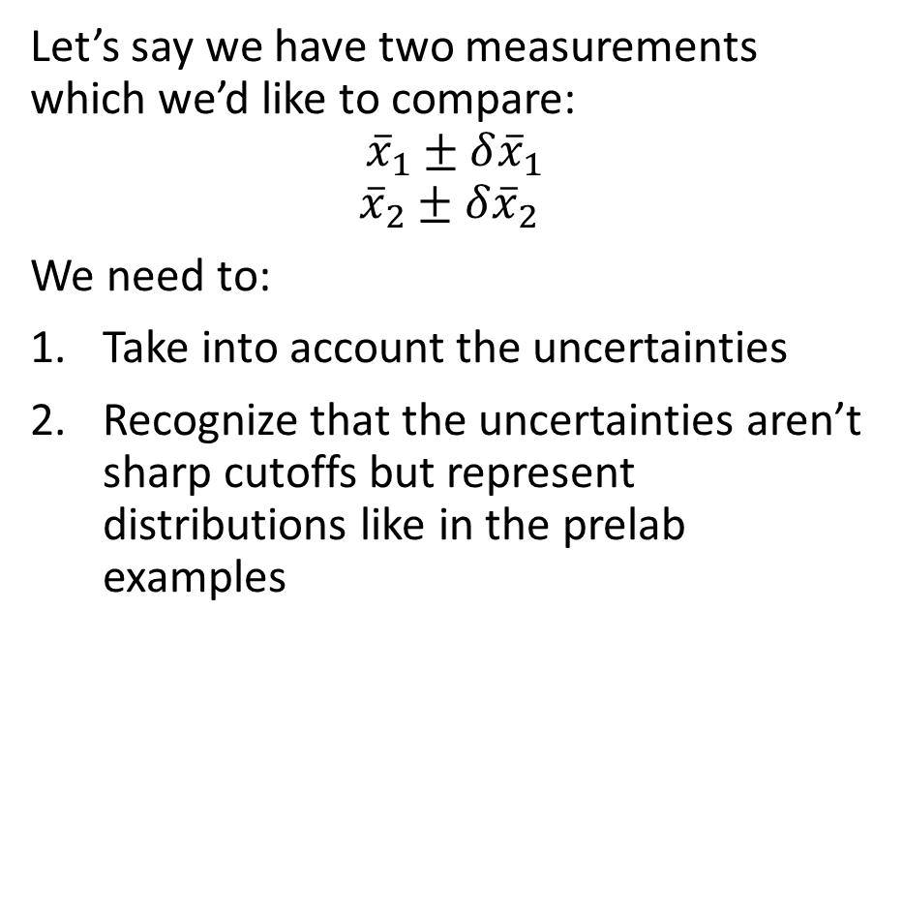
Comparing Measurements
Let’s say we have two measurements which we’d like to compare:
$${\overline{x}}_{1}±δ{\overline{x}}_{1}$$
$${\overline{x}}_{2}±δ{\overline{x}}_{2}$$
We need to:
Take into account the uncertainties
Recognize that the uncertainties aren’t sharp cutoffs but represent distributions like in the prelab examples

Slide 5
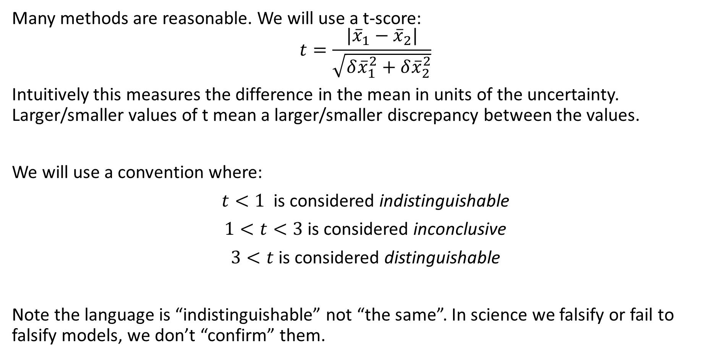
Comparing Measurements
Many methods are reasonable. We will use a t-score:
$$t=\frac{|{\overline{x}}_{1}−{\overline{x}}_{2}|}{\sqrt{δ{\overline{x}}_{1}^{2}+δ{\overline{x}}_{2}^{2}}}$$
Intuitively this measures the difference in the mean in units of the uncertainty. Larger/smaller values of t mean a larger/smaller discrepancy between the values.
We will use a convention where:
$t<1$ is considered indistinguishable
$1<t<3$ is considered inconclusive
$3<t$ is considered distinguishable
Note the language is “indistinguishable” not “the same”. In science we falsify or fail to falsify models, we don’t “confirm” them.

Slide 6
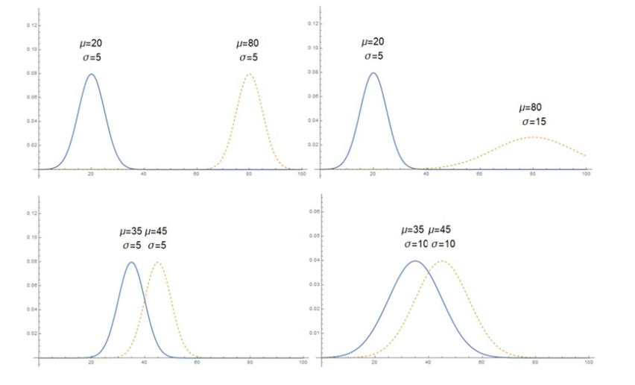








Comparing Measurements
We can apply this to the prelab examples to connect intuition with the mathematical expression:
$$t=\frac{|20−80|}{\sqrt{5^{2}+5^{2}}}≈8.5$$
$$t=\frac{|20−80|}{\sqrt{5^{2}+{15}^{2}}}≈3.8$$
$$Distinguishable$$
$$Distinguishable$$
$$t=\frac{|35−45|}{\sqrt{5^{2}+5^{2}}}≈1.4$$
$$t=\frac{|35−45|}{\sqrt{{10}^{2}+{10}^{2}}}≈0.7$$
$$Inconclusive$$
$$Indistinguishable$$

Slide 7
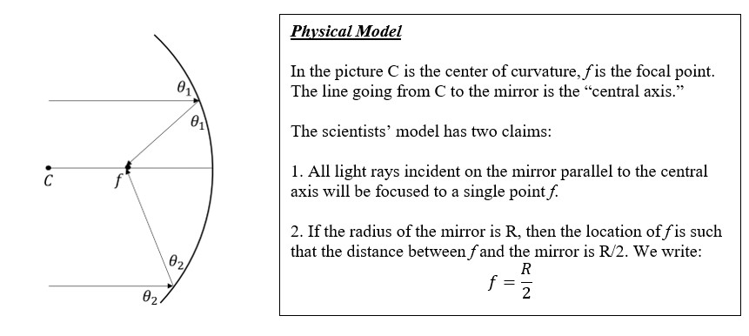
Law of Reflection on a Curved Mirror

Slide 8
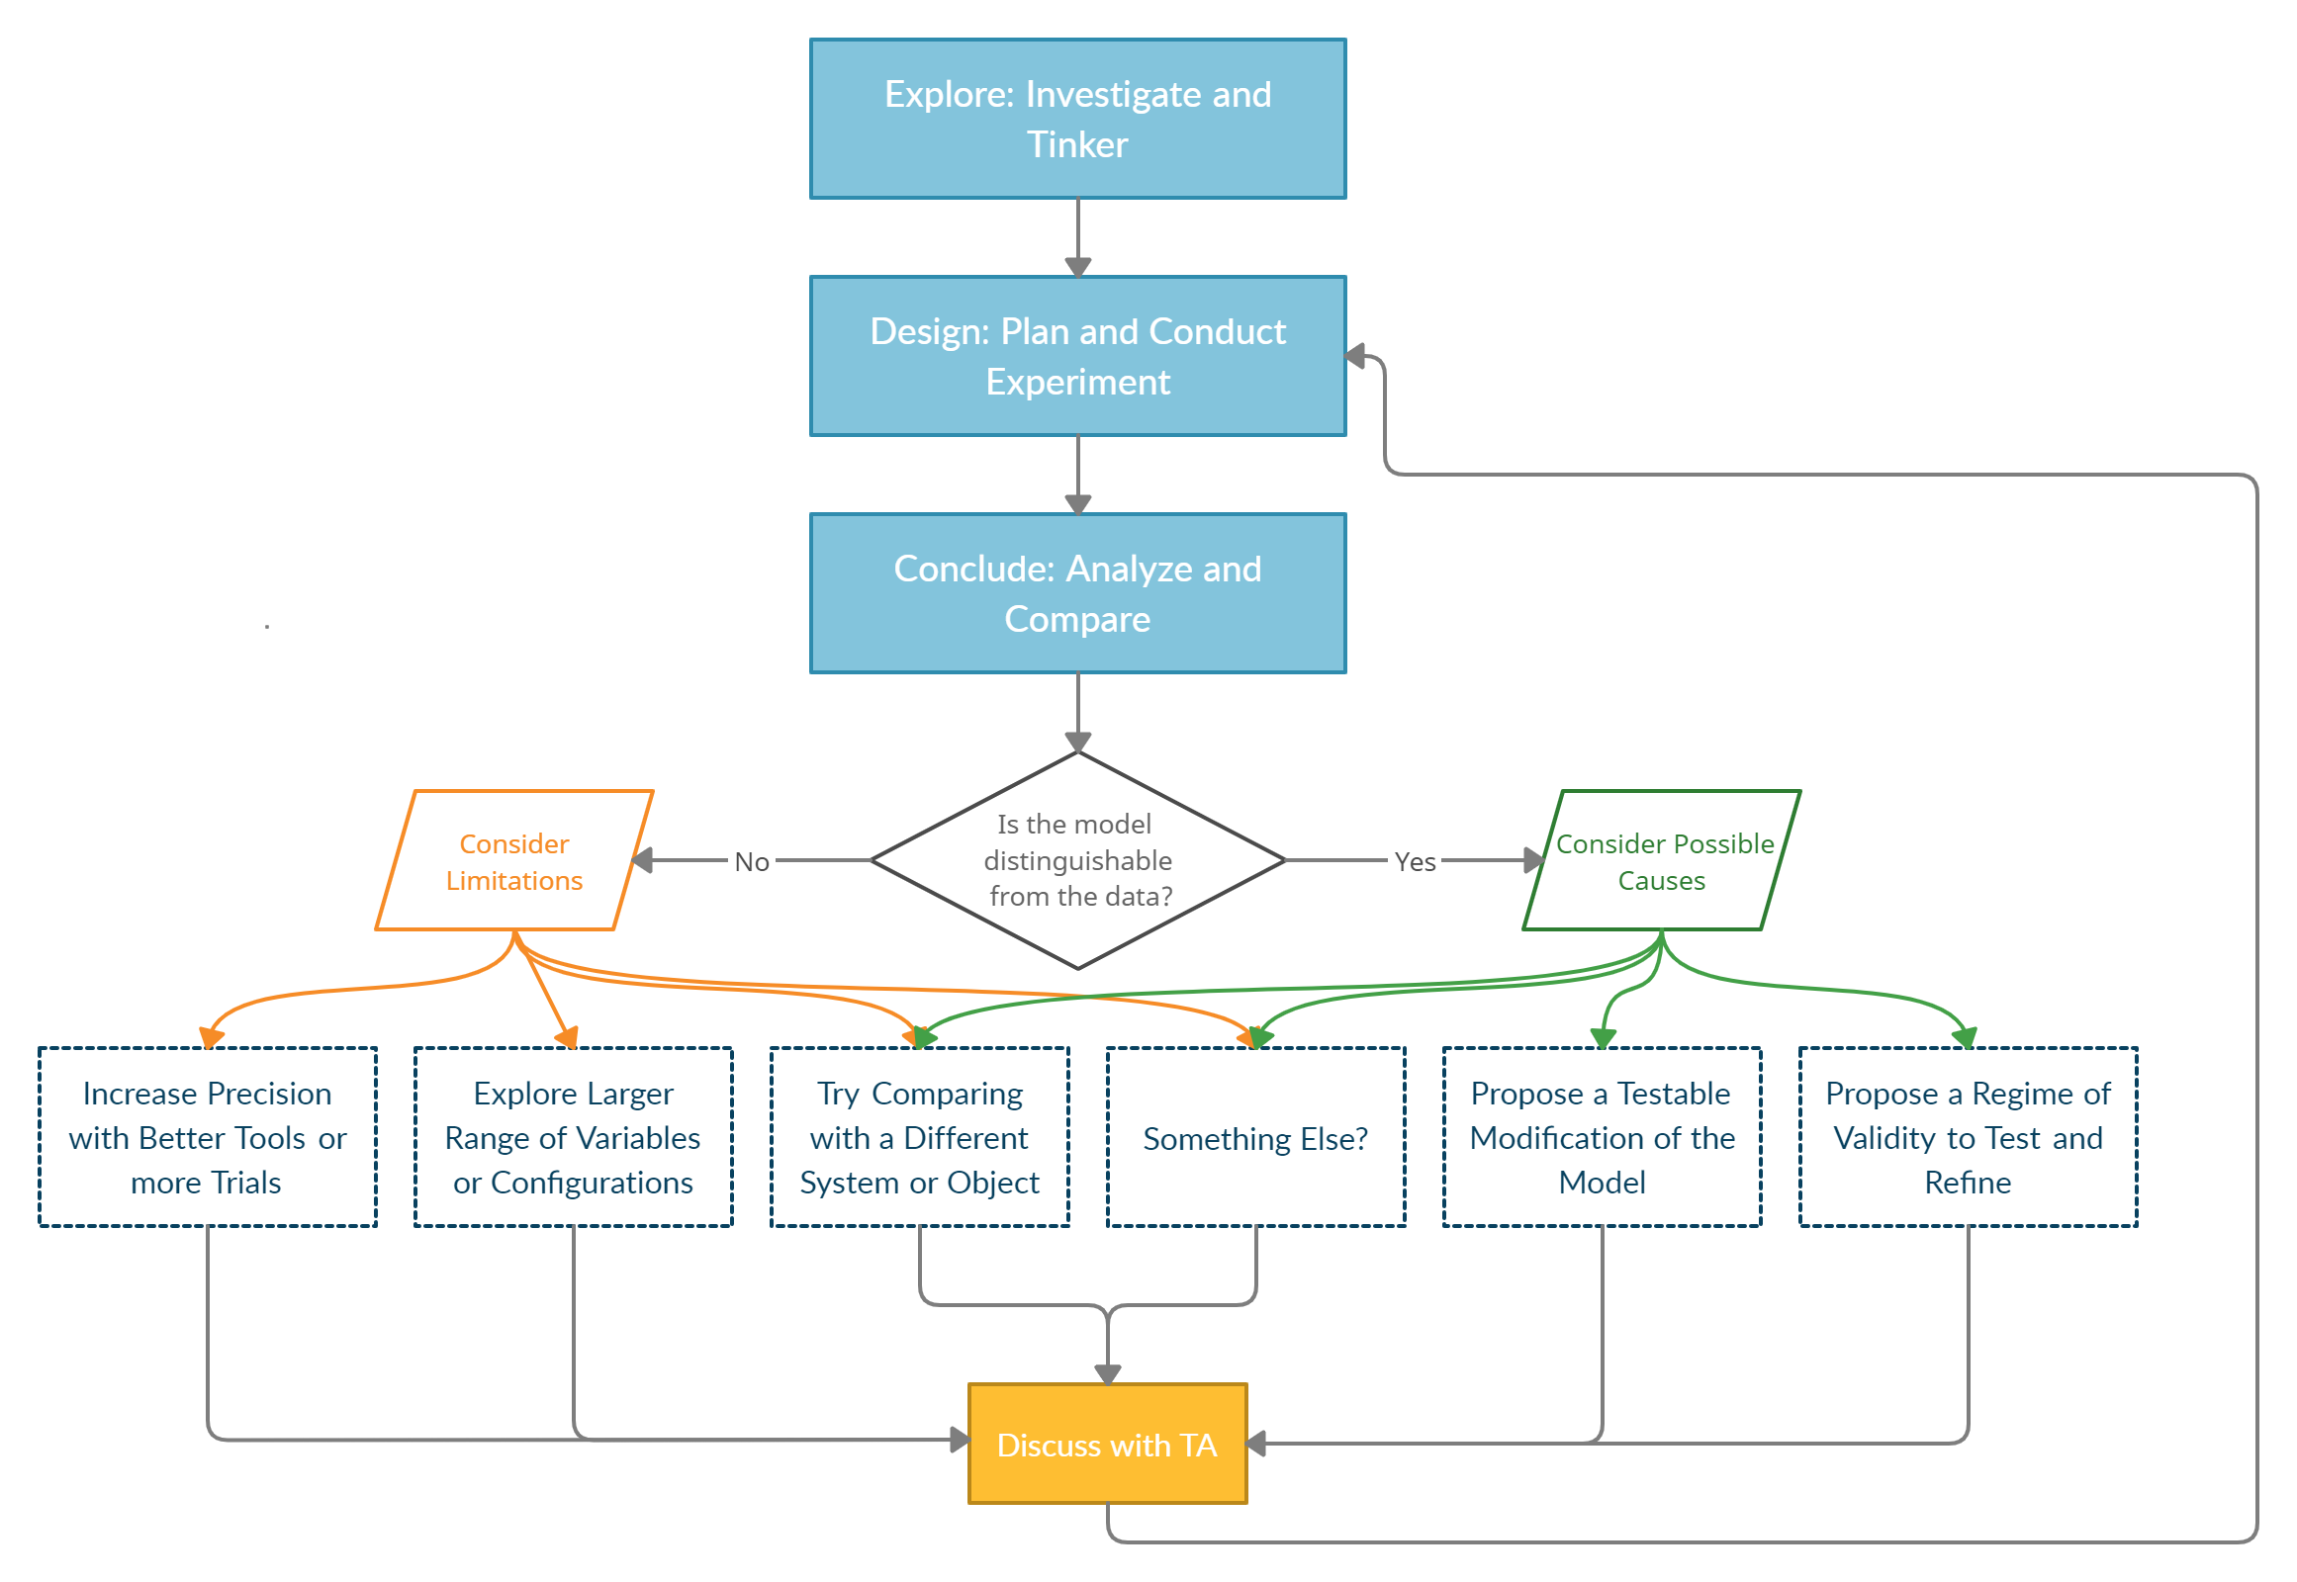
Lab 1 and the flow chart
Overview
Test the 2 Scientist claims using curved mirror and a light source
After part 1, write your result on the board (R/2 and f) with uncertainty and wait for the TA to discuss the result before moving to part 2
Safety Concerns!

Slide 9
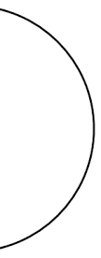
Focal point of single ray
Curved mirror
Incident ray
Focal length
f= focal point
Reflected ray

Slide 10



Focal points of multiple rays
Curved mirror
Incident ray
$$f_{2}$$
$$f_{1}$$
$$f_{3}$$
Reflected ray
Not the focal point

Slide 11
Lab 1
Overview
Setups are almost identical to Lab 0, just with curved mirrors
Safety Concerns!

